Slide 1
Notes:
OSHA is focusing on reducing trenching and excavation hazards. Trench collapses, or cave-ins, pose the greatest risk to workers' lives. To prevent cave-ins:
SLOPE or bench trench walls
SHORE trench walls with supports, or
SHIELD trench walls with trench boxes

Slide 2
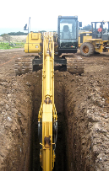
Agency Priority National Emphasis Program on Trenching & Excavating
→ Reduce Trenching Hazards Through Enforcement and Compliance Assistance
Oct 1, 2018 - National Emphasis Program on Trenching & Excavation
→ CSHOs shall initiate inspections under this NEP whenever they observe an open trench or an open excavation, regardless of whether or not a violation is readily observed.
Notes:
National Emphasis Programs (NEPs) are temporary programs that focus OSHA's resources on particular hazards and high-hazard industries. Existing and potential new emphasis programs are evaluated using inspection data, injury and illness data, National Institute for Occupational Safety and Health (NIOSH) reports, peer-reviewed literature, analysis of inspection findings, and other available information sources.

Slide 3
OSHA Penalty Levels: 2025
Type of Violation | New Maximum
Serious and Other-Than-Serious Posting Requirements | $16,550 per violation
Willful or Repeated | $165,514 per violation
Failure to Abate | $16,550 per day beyond the abatement date
www.osha.gov/penalties
Notes:
[Note to presenters: For a PPT on OSHA’s penalty levels, see the O drive at DCSP/CAS Resources/Presentations/Penalties/.]
Below are the maximum penalty amounts, with the annual adjustment for inflation, that may be assessed after Jan. 15, 2023.

Slide 4
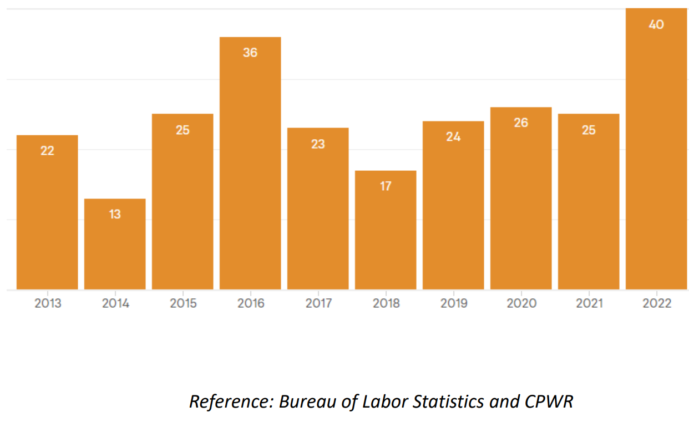
OSHA Trench Fatality Investigations
Notes:
BLS Trench Fatality Data from 2013 -2022 Private Sector

Slide 5
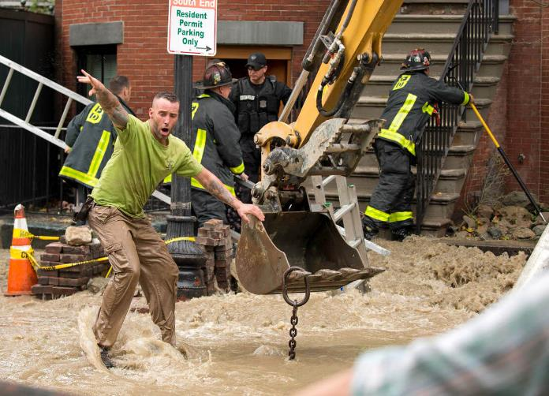
Atlantic Drain Trenching Fatality

Slide 6
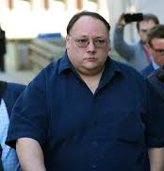
Criminal Investigation Team
The owner of a company involved in a deadly trench collapse in Boston three years ago has been convicted on two counts of manslaughter in connection with the incident that killed two workers.
Atlantic Drain Service and owner Kevin Otto were found guilty Thursday in a jury-waived trial in Suffolk County Superior Court, the office of District Attorney Rachael Rollins said.
Robert Higgins and Kelvin Mattocks, employees of Atlantic Drain Service Co., were killed on Oct. 21, 2016, when the trench in which they were working collapsed and filled with water from a fire hydrant supply line.

Slide 7
On-Site Consultation Program
Primarily for smaller businesses, no-cost, confidential consultations help employers identify and address hazards and establish or improve safety and health programs. Services are provided by consultants from state agencies or universities.
Did you know that the OSHA On-Site Consultation Program prevents over 8,700 workplace injuries and saves the U.S. economy almost $1.5 billion every year? Learn more about how OSHA On-Site Consultation benefits small business employers, workers, and the worker's compensation system.

