Slide 1
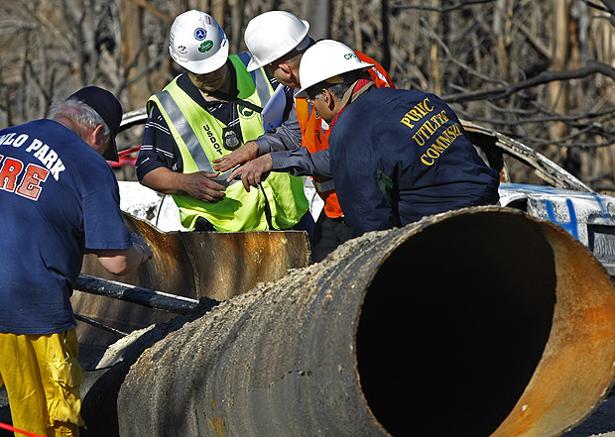
jcomp
Pipeline and Hazardous Materials Safety Administration
(PHMSA)
Office of Pipeline Safety
Why Safe Excavation Is So Important To Us
April 1, 2025
South Burlington, Vermont

Slide 2
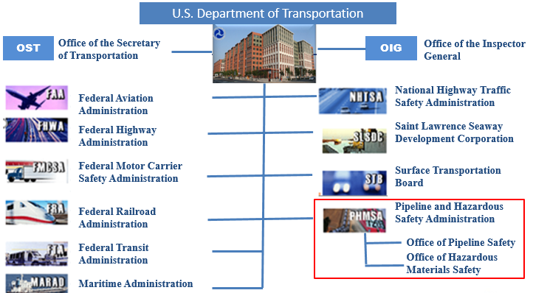
What is PHMSA?
2

Slide 3
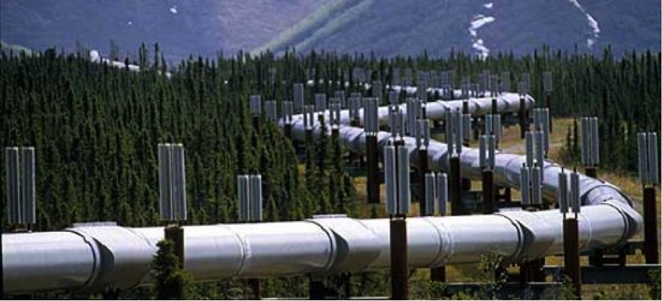
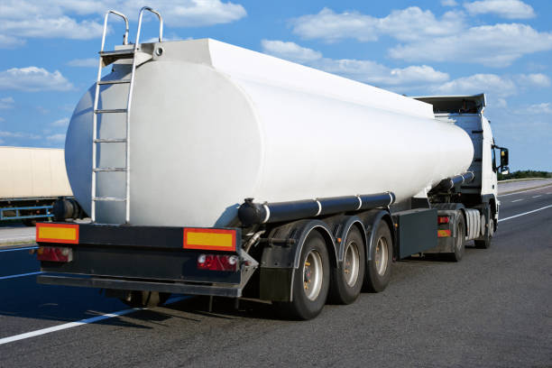
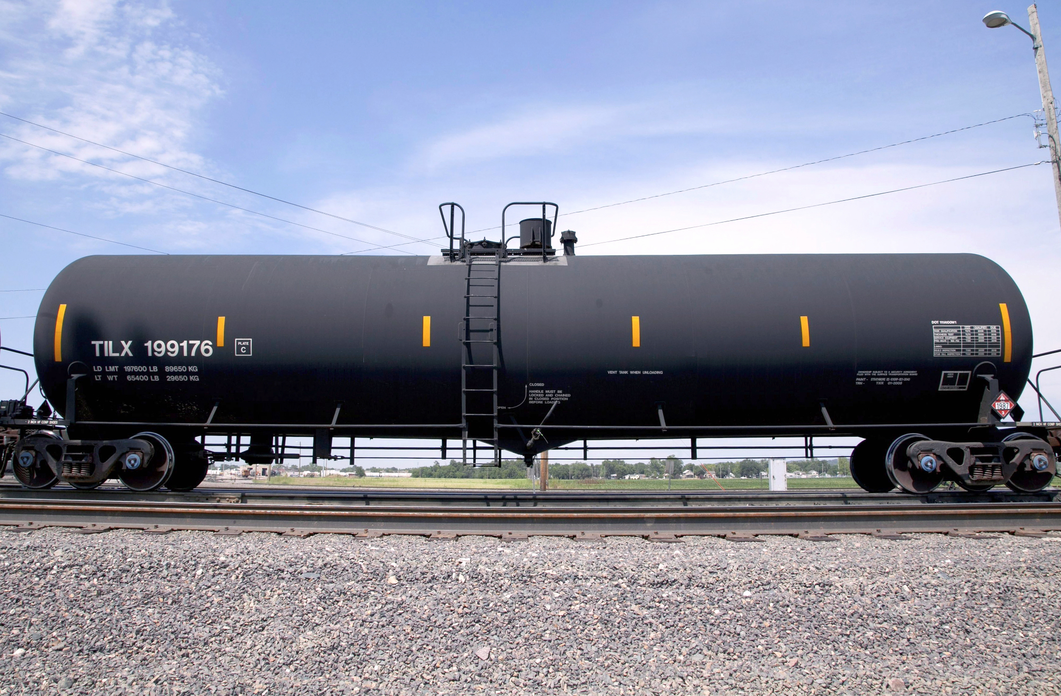
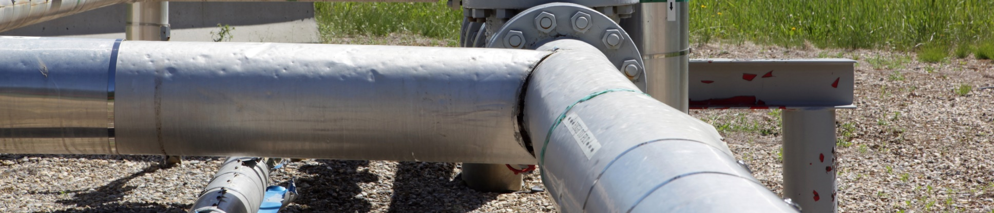
Mission
To protect people and the environment by advancing the safe transportation of energy and other hazardous materials that are essential to our daily lives.
PHMSA By the Numbers
3.3 Million | 1.2 Million | 16,700 | 1.6 Billion | 64%
Miles of Regulated Pipelines | Daily Shipments of Hazardous Materials | Underground Natural Gas Storage Wells | Tons of Hazardous Materials Shipped Annually by All Modes | Of U.S. Energy Commodities Transported by Pipeline

Slide 4





All Regulated Pipelines Have Something In Common
All Pipelines Have Something In Common
No matter the size, pressure, or operator,
all PHMSA-regulated pipelines carry
HAZARDOUS MATERIALS
that can pose serious risks
to people and the environment.

Slide 5


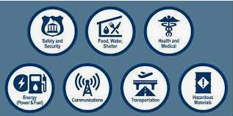
Why PHMSA’s Here

Slide 6
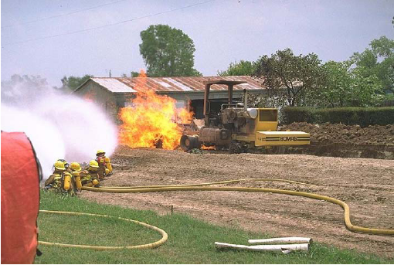
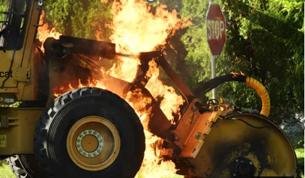
Past Accidents

Slide 7

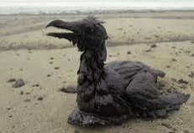

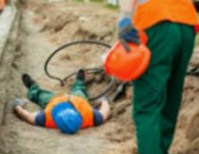

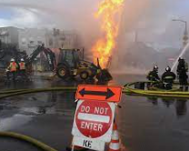


Some Risks of Accidental Strike… Why Risk It?
Environmental Damage
Reputation Damage
Loss of Life
Injury
Financial Implications
Explosion
Project Delays
Legal Action

Slide 8
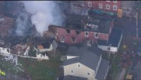
Past Incident Example

Slide 9

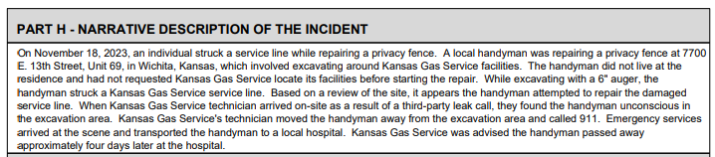
Another Incident Example

Slide 10
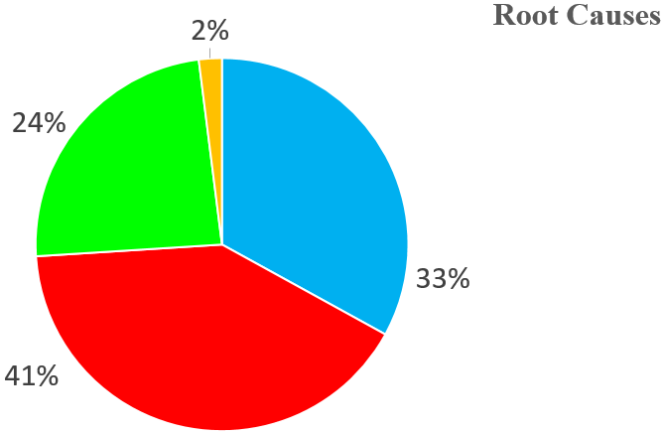
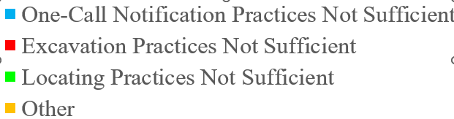
2023 Excavation Damages on Gas Distribution Pipelines
87,010 Excavation Damages
Please ask yourself, “Am I notifying Dig Safe and following safe excavation practices?”
Data as of 1/21/2025 for CY 2023; Operator Annual Reports due March 15th for preceding calendar year.
10

Slide 11
Regulatory Requirements
Title 49 Code of Federal Regulations
Part 190: Pipeline Safety Programs/Rulemaking
Part 191: Reporting Requirements
Part 192: Natural Gas Pipelines
Part 193: LNG Facilities
Part 194: Oil Spill Response Plans (OPA)
Part 195: Hazardous Liquid Pipelines
Part 196: Protection of Pipelines From Excavation
Part 198: State Grants
Part 199: Drug and Alcohol
Excavators Must Follow
www.ecfr.gov
11

Slide 12

Some Important Definitions in the
Federal Pipeline Safety Regulations
Excavator means any person or legal entity, public or private, proposing to or engaging in excavation.
Excavation refers to excavation activities as defined in 192.614 and covers all excavation activity involving mechanized and non-mechanized equipment, including hand tools.
  192.614 states that excavation activities includes excavation, blasting, boring, tunneling, backfilling, the removal of aboveground structures either by explosive or mechanical means, and other earthmoving operations.
12

Slide 13
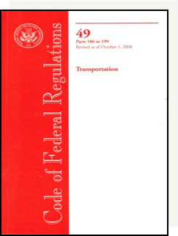
Federal Standard for Excavators
Notify 811 (Dig Safe) before excavating
Wait for pipeline operators to establish and mark the location of underground pipelines before excavating
Excavate with proper regard for the marks by taking all practicable steps to prevent excavation damage
13

Slide 14
Federal Standard for Excavators
Make additional use of 811 as necessary
Report any contact with pipelines to pipeline operator at earliest practical moment
Call 911 if there is a release
NOTES:
State laws may have additional and/or more stringent requirements.
State Offices in New England States (MA DPU, ME PUC, NH DOE, RI DPUC, VT DPS) perform enforcement for State excavation damage prevention laws.
There are no exemptions in the Federal rule. PHMSA will be considerate of exemptions in State laws when undertaking federal enforcement action.
14

Slide 15

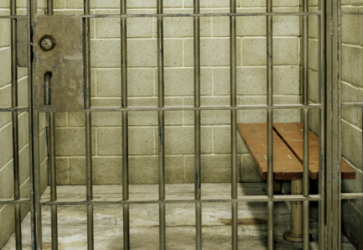
Federal Penalties for Violators
Civil Penalties
  Up to $272,926* for each violation
  Separate violation occurs for each day the violation continues (maximum for series of violations: $2,729,245*)
Criminal Penalties
  Fine, imprisonment for not more than 5 years, or both, for each offense
* 89 FR 106282, December 30, 2024, Final Rule for 2025 inflation adjustment; Federal agencies are required to adjust their civil monetary penalties each year to account for changes in inflation in accordance with Federal Civil Penalties Inflation Adjustment Act Improvements Act of 2015 (Pub. L.114-72).
15

Slide 16
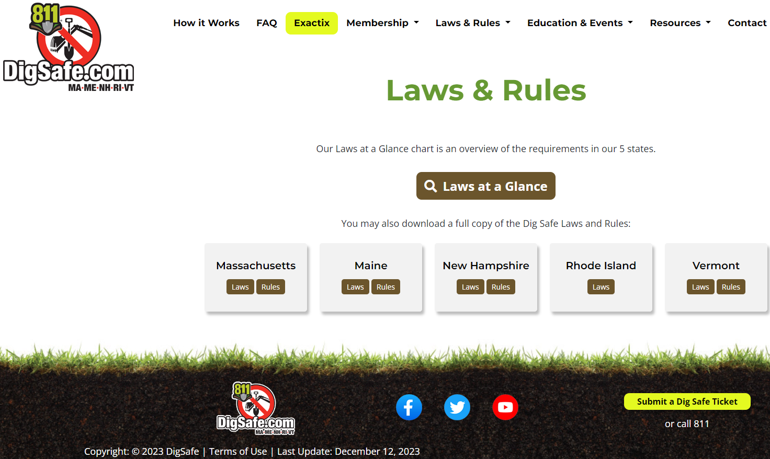
State Damage Prevention Laws
Most State Damage Prevention Laws and Regulations are More Specific than the Federal Standards for Excavators
www.digsafe.com/laws-and-rules
16

Slide 17

Common Ground Alliance Best Practices
Chapters and Appendices
1 – Introduction
2 – Planning and Design
3 – 811 Center
4 – Locating and Marking
5 – Excavation
6 – Mapping
7 – Compliance
8 – Public Education and Awareness
9 – Reporting and Evaluation
10 – Miscellaneous
Appendix A – Glossary of Terms and Definitions
Appendix B – Uniform Color Code and Marking Guide
Appendix C – Sample Forms, Reports, and Releases
Appendix D – Additional References
https://bestpractices.commongroundalliance.com
17

Slide 18


Safety is a Shared Responsibility and
Communication is Key
We all must do our part to ensure safety
For any questions, concerns, or uncertainties when working around pipelines, resources include:
  Pipeline operators (and other utilities)
  Regulators (state and federal)

Slide 19
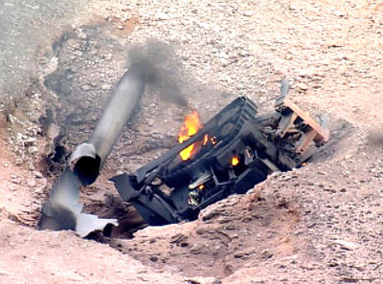

Bottom Line: Dig Safe to Stay Safe
19

Slide 20
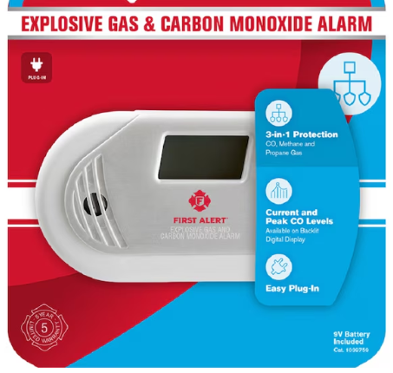

Be Safe at Home Too
Natural Gas or Propane at Home?
Please Consider Getting One of These
20

Slide 21
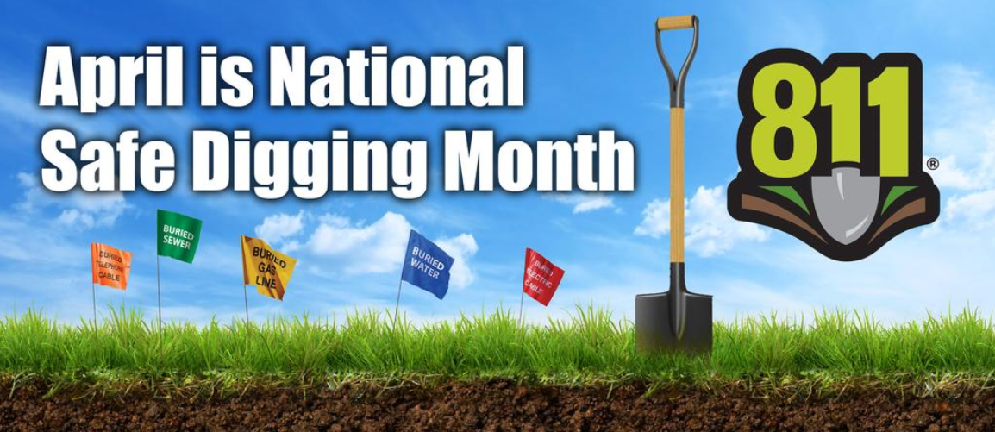

… and Please Help Spread the Safety Message
www.call811.com
21

Slide 22



Pipeline Safety Questions…
Karen Gentile
Community Liaison – Eastern Region
PHMSA Office of Pipeline Safety
Karen.Gentile@dot.gov
Phone: 609-433-6650

Slide 23

Please Let Me Know How I Did
23

Slide 24
Additional Information and Resources

Slide 25
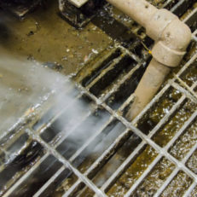
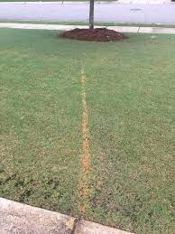
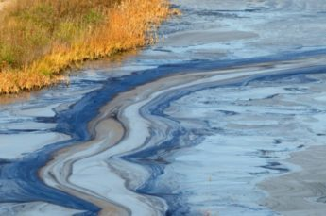
How to Recognize a Pipeline Leak?
All Pipelines Have Something In Common
Sight: Liquid pools, discolored or abnormally dry soil/vegetation, continuous bubbling in wet or flooded areas, an oily sheen on water surfaces, vaporous fogs, blowing dirt around a pipeline area, or fire coming from the ground or appearing to burn aboveground can all be indicative of a pipeline leak
Sound: Volume can range from a quiet hissing to a loud roar depending on the size of the leak
Smell: An unusual smell, petroleum odor, or gaseous odor – like rotten eggs will sometimes accompany pipeline leaks

Slide 26


What Should You do if You Suspect or Detect a Leak?
All Pipelines Have Something In Common
Turn off gas appliances
Leave the area by foot immediately
Do not try to locate the source of the odor or leak.
Try to direct other individuals to leave the area and attempt to stay upwind of the suspected leak area
Call 911 from a safe location; then, notify the pipeline company and or your local emergency response number if known. Provide the emergency operator your name, phone number, a brief summary of the incident, and the location

Slide 27
What Should You NOT do if You Suspect or Detect a Leak?
All Pipelines Have Something In Common
DO NOT :
Come into direct contact with any escaping liquids or gas
Attempt to operate any pipeline valves yourself
Cause any open flame or other potential source of ignition
Use a telephone or cell phone near the leak
Ring doorbells to notify others of the leak; knock instead
Drive into a leak or vapor cloud while leaving the area
Attempt to extinguish a natural gas fire

Slide 28
Resources
Community Toolbox
http://primis.phmsa.dot.gov/comm/
Pipeline Terminology and Basics
https://www.phmsa.dot.gov/safety-awareness/pipeline/safety-awareness-overview
Grant Opportunities
https://www.phmsa.dot.gov/about-phmsa/working-phmsa/grants
PHMSA Homepage
www.phmsa.dot.gov
Federal Regulations
www.ecfr.gov
Excavation Enforcement Rule
www.phmsa.dot.gov/pipeline/excavator-final-rule/about-excavation-enforcement-final-rule
National Pipeline Mapping System
www.npms.phmsa.dot.gov

